Slide 1
IMPACT OF COVID-19 ON SUB-URBAN TRAINS
By-
Akhilesh Hothur
Gaddam Uttej Reddy
Smitha TC
Rudra Nath Maji

Slide 2
Introduction
Covid-19 has made a huge impact in the regular life of peoples throughout the world and India is no exception.
India is slowly trying to move out of the lockdown phase and situations are trying to adapt normalcy, so is the condition with Indian Railways.
In this project we tried to shed light on the impact of movement of sub-urban trains in a busy city like Kolkata where local trains serve as a major from of transportation for many.

Slide 3
Problem Statement
We want to derive the spread of infections resulting from movement of trains which will give us some idea about the number of infected people at every station of a particular route.
Comparing the above data with the available medical facility in those affected regions, we would be able to comment on the number of trains to be run on that route.

Slide 4
Breaking down of the problem
The first objective of the problem is to generate the number of people getting infected within the train.
To establish the infected people inside the train, we first need to understand the train simulation network whose output will generate the number of peoples boarding and de-boarding at different stations.
Using the output of the train simulation, we can run the contact network simulation model wherein we can get an idea of the people coming in contact during the travel and hence the number of people getting infected in the train.

Slide 5
Contd...
Once we get to know the number of infected people at different stations, we can utilise a static SIR Model ( we are thinking of a static model because of our assumption that the travelling is taking place through railways only) to generate the spread of infection at each and every station.
We will collect the available medical facility(Number of COVID Hospitals and beds available) at each station of that route.
The bottleneck station will guide on the number of trains to be run on that route.

Slide 6
Literature review on development of contact network
We have considered as paper on ‘ Modelling epidemic spreading through public transit using time-varying encounter network ‘ to understand the concepts of epidemic spreading through public transport (PT) system and Social Activity(SA) System.

Slide 7
Types of Contact Network
In this study, two components of the contact network are considered:
A PEN that is designated to capture the interaction of passengers on PT,
An SA contact network that captures all other interactions among people.

Slide 8
Public-transport Encounters Network
PT encounters are defined as those who have ever stayed in the same vehicle in a PT system.
It is an undirected graph with each node representing a passenger and each edge indicating the paired passengers that have stayed in the same vehicle.
We assume passengers staying in a same vehicle are close enough to trigger infections.
We first evenly divide the whole study period into different time intervals t = 1,…,T. The length of each interval is τ.

Slide 9
Social Activity Contact Network
In addition to contacts during rides on the PT, passengers may also contact each other during their daily social activities. They made the following assumptions to build the SA contact network:
Global interaction: Passengers may interact with any other individuals in the system during a time interval of t with a uniform probability of θg .
Local interaction: Passengers with same origins or destinations of PT trips may interact with each other during time interval t with a uniform probability θℓ. Since local interaction is more intense than global interaction, we have θℓ > θg .

Slide 10
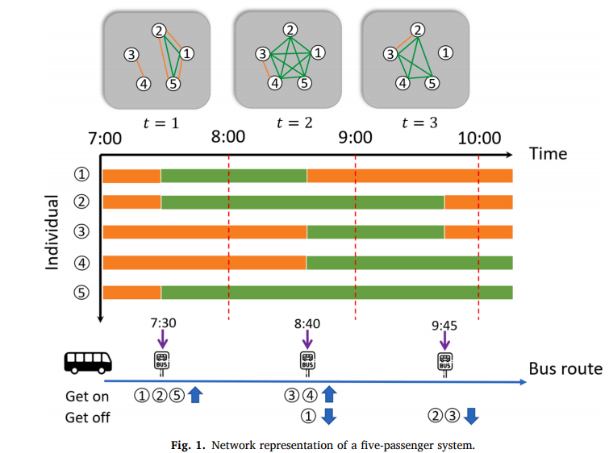
Sample Calculation

Slide 11
Train Simulation Framework
Aim: To Simulate Boarding and Deboarding of Passengers in Train.

Slide 12

Passenger Details:
Consider each passenger as one agent.
Each agent has unique agent identification number, boarding station , deboarding station and compartment in which he travelled .
Ex:
At any point of time we can track any passenger based on its unique agent identification number.

Slide 13
Train Details:
Assumptions
Number of compartments : 12
Maximum capacity of each compartment:300
Number of stations : 34
Representation
list of dictionaries each representing one compartment of the train.
Each compartment has 2 attributes :
Compartment number
Current population

Slide 14
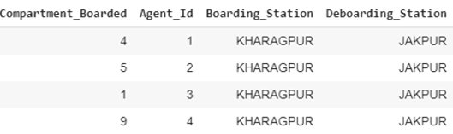
While simulating the train we store the each passenger details in one dataframe. So if we wants to know the information of particular passenger after simulation .We can retrieve from this dataframe.
Ex :

Slide 15
Steps in Train Simulation
Creating Population
De-Boarding
Boarding
Extra Passenger
Creating passengers population to board the train for current station according to mobility pattern dataset.
Passengers having deboarding station as current station will be found from train and will be removed from the train.
From the generated station agents population in first step random num of people will board in each compartment.
If the passenger is trying to board the full compartment which he can’t then passenger will search neighbouring empty compartment and will board in it .

Slide 16

Agents Contact Network
Aim: Create agents contact network on output obtained from train simulation framework

Slide 17
Python library networkx is to create this network.
Firstly all the possible edge pairs between agents who travelled in same compartment is found.
Ex. edge pairs for agents [1,2,3] are [(1, 2), (1, 3), (2, 3)]
Then a graph is created, nodes and edges between nodes are added according to our generated agent edges pairs.
At the time of adding edge between two agents we calculate the time they travelled together and add that as weight of that particular edge.

Slide 18
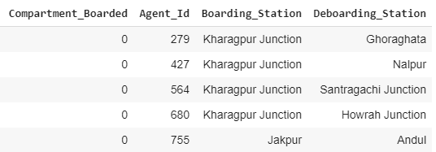
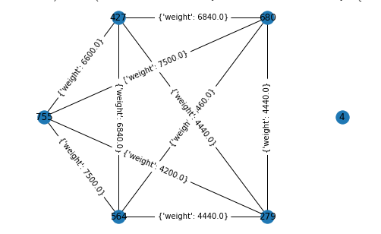
Since it is very hard to visualise all 5 thousand node at once. We have visualised Subgraph consisting of 4-5 nodes to see how network looks. .

Slide 19
Suspension time of virus is added as a parameter in the network.
Weight of edge = Ts – Td , if Ts > Td
= 0 , else
Ex:
Time difference between BALICHAK and RADHAMOHANPUR stations is 480 sec and lets virus suspension time=600 sec. since 480 < 600 sec, there will be link between them with weight 120 sec.
Output link : (Agent1,Agent2, {'weight': 120.0})

Slide 20
Results
Finally, we get Contact network with 5321 nodes and link between them according to our defined criteria.
Suspension time​ | No of edges​ | AVG degree of network​
0 sec​ | 809215​ | 309​
120 sec​ | 857144​ | 328​
600 sec​ | 892181​ | 341​

Slide 21
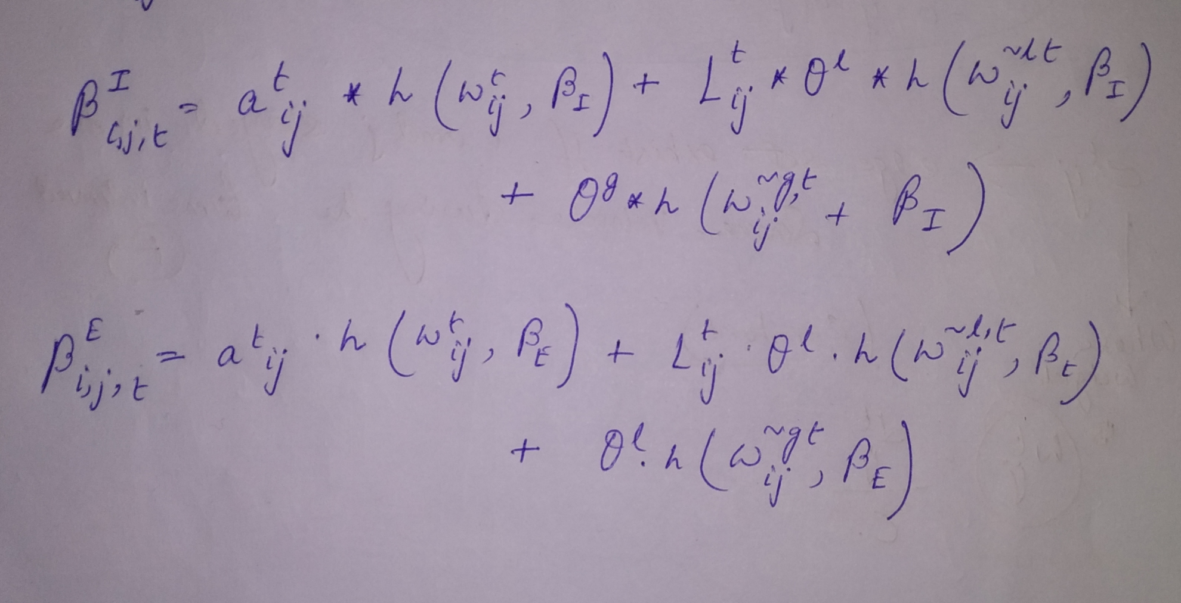
Equations to estimate the probability of infected nodes

Slide 22
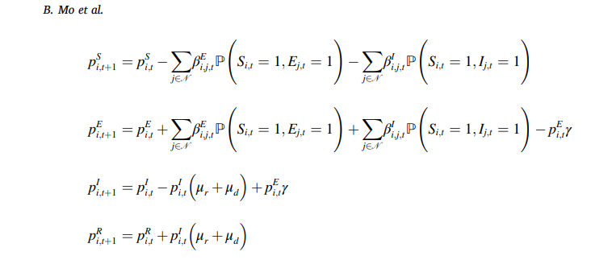
Infection probability for individual in S,E,I,R categories

Slide 23
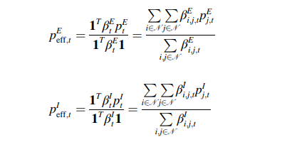
Total effective proportion exposed to infection
In a network environment, the state of each node is affected by the state of its immediate neighbours.
Therefore, we can characterize the effective state of the system using the average nearest-neighbour activity

Slide 24

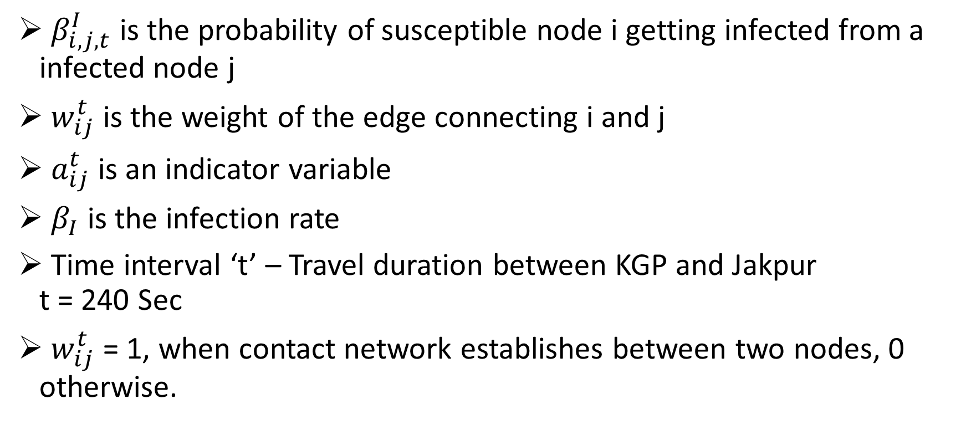
Calculation of individual infection
$β_{i,j,t}^{I}$ is the probability of susceptible node i getting infected from a infected node j
$w_{ij}^{t}$ is the weight of the edge connecting i and j
$a_{ij}^{t}$ is an indicator variable
$β_{I}$ is the infection rate
Time interval ‘t’ – Travel duration between KGP and Jakpur t = 240 Sec
$w_{ij}^{t}$ = 1, when contact network establishes between two nodes, 0 otherwise.

Slide 25
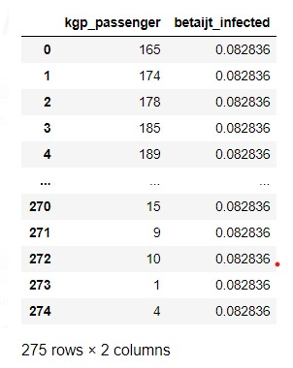
Calculation of individual infection
There are 275 passengers boarding @ KGP and 5 passengers de-boarding at Jakpur

Slide 26
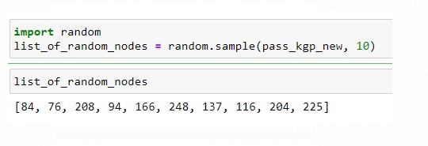
Random selection of seed infected
We have randomly selected 10 infected people out of 275 boarding at KGP.

Slide 27


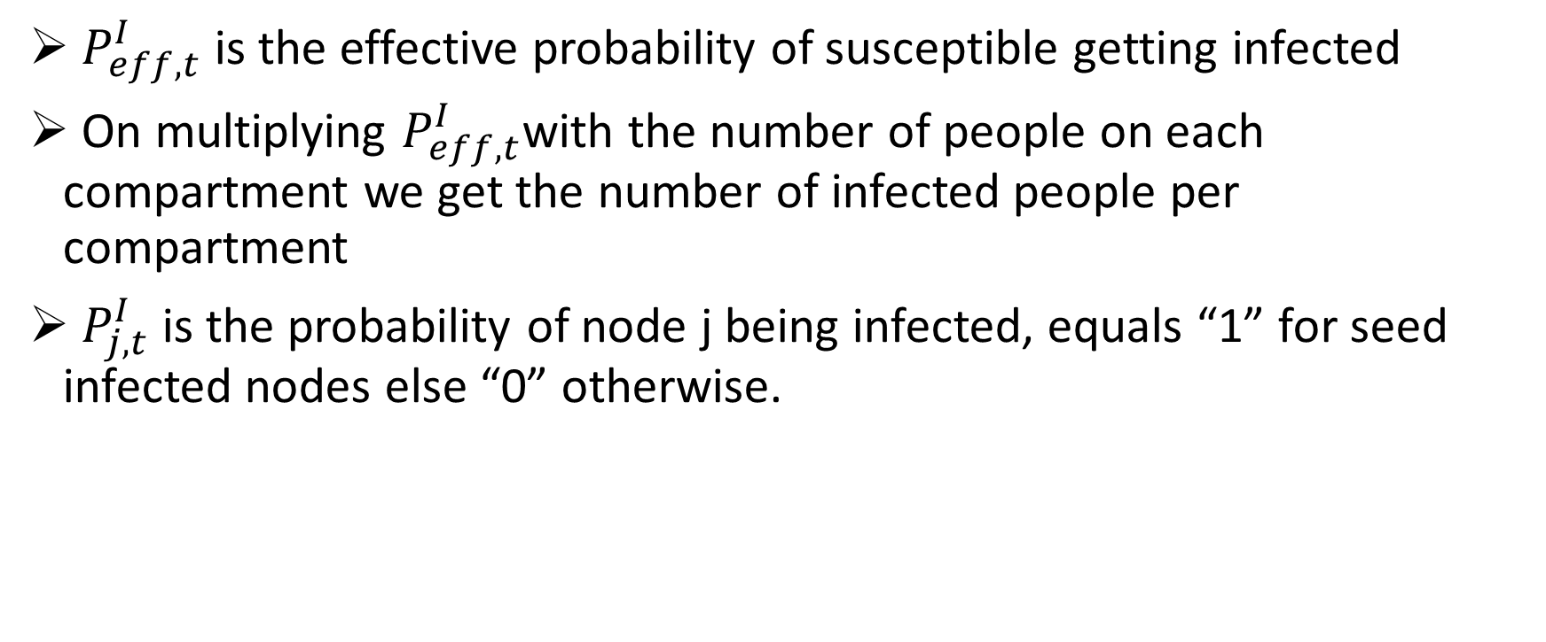
Effective Calculation
$P_{eff,t}^{I}$ is the effective probability of susceptible getting infected
On multiplying $P_{eff,t}^{I}$with the number of people on each compartment we get the number of infected people per compartment
$P_{j,t}^{I}$ is the probability of node j being infected, equals “1” for seed infected nodes else “0” otherwise.

Slide 28
1st Time Interval
Peff = 6.60%
Number of infected people in the train after time-interval t =1 is = (265*0.0660) + 10 = 27.49 = 28 (Approx.)
Number of infected people de-boarding at Jakpur = 5*0.0660 = 0.33 = 1 (approx.)(Node 2)
Need to identify the infected nodes, which got infected in the travel from KGP to JAKPUR so that we can further trace the spread of infection.

Slide 29
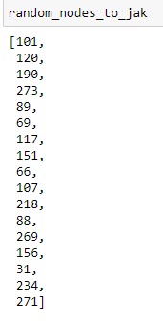

1st Time Interval
To do so, we have calculated the contacts developing between the infected nodes boarding at KGP and the remaining peoples travelling in train (Susceptible peoples) from KGP to JAKPUR.
Out of the these contacts the nodes involved in maximum contacts are selected randomly based on the peff value.
The nodes getting infected during 1st Time Interval:

Slide 30
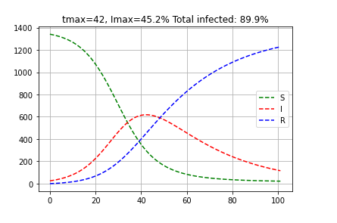
Spread of infection in JAKPUR
Applying the SIR Model with population of JAKPUR = 1341 and infected peoples= 1*25trains = 25

Slide 31
Between 1st and 2nd Time Interval
Between two time intervals 13 peoples boarded at JAKPUR.
Assuming similar epidemic situation prevailing throughout the journey.
Therefore number of infected people boarding the train at JAKPUR are : (10/275)*13 = 0.472 = 1 (Approx)(Node 281)
Therefore total infected people when train starts from JAKPUR is = 10+18-1+1 = 28
The infected nodes are : 281,101,120,190,273,89,69,117,151,66,107,218,88,269,156,31,234, 271,84,76,208,94,166,248,137,116,204,225

Slide 32
2nd Time Interval
Train travelling from JAKPUR to MADPUR
Total contacts established in this duration is 5502
Contacts taking place with infected nodes = 580
Peff = 580/5502 = 0.1054 = 10.54%
Number of newly infected people in the train in time-interval t =2 is
= (275-5+13-28)*0.1054 = 26.88 = 27 (Approx.)
Number of infected people de-boarding at MADPUR = 0.1054*11 = 1.12 = 2 (Approx)(Node12 and Node 276)
Total infected people in train = 27 + 28 = 55 peoples.

Slide 33
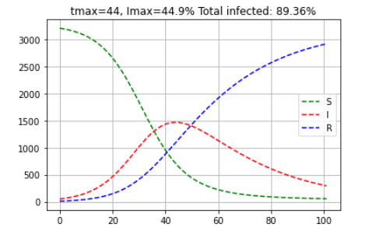
Spread of infection in Madpur
Applying the SIR Model with population of MADPUR = 3210 and infected peoples= 2*25trains = 50

Slide 34
Between 2nd and 3rd Time Interval
Number of peoples boarding at MADPUR = 33
Infected peoples boarding at MADPUR = (10/275)*33 = 1.2 = 2(Approx) (Node 313 and Node 315)
Total infected people in train when train starts at MADPUR = 57

Slide 35
3rd Time Interval
Train is travelling from MADPUR to SHYAMCHAK
Totals contacts taking place = 6435
Contacts taking place with infected nodes = 1606
Peff = 1370/6435 = 0.2496 = 24.96%
Number of newly infected people in the train in time-interval t =3 is
= (275-5+13-11+33-57)*0.2496 = 61.9 = 62 (Approx.)
Number of infected people de-boarding at SHYAMCHAK = 0.2496*6 = 1.49 = 2 (Approx)
Total infected people in train = 28+ 27 + 62 = 117 peoples.

Slide 36
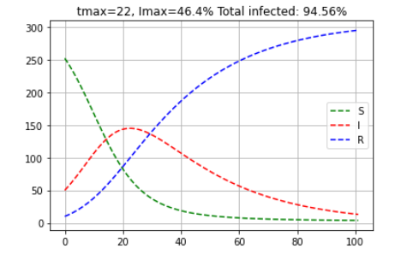
Spread of infection in Shyamchak
Applying the SIR Model with population of SHYAMCHAK = 252 and infected peoples= 2*25trains = 50

Slide 37
Between 3rd and 4th Time Interval
Number of peoples boarding at SHYAMCHAK = 46
Infected peoples boarding at SHYAMCHAK = (10/275)*46 = 1.672 = 2(Approx)
Total infected people in train when train starts at SHYAMCHAK =
28+ 27 -2 + 2 + 62 -2 + 2 = 117

Slide 38
4th Time Interval
Train is travelling from SHYAMCHAK to BHALICHAK
Totals contacts taking place = 11006
Contacts taking place with infected nodes = 4124
Peff = 4124/11006 = 0.3747 = 37.47%
Number of newly infected people in the train in time-interval t =4 is
= (275-5+13-11+33-6+46-117)*0.3747 = 72 (Approx.)
Number of infected people de-boarding at BHALICHAK= 0.3747*30 = 12 (Approx)
Total infected people in train = 28+27+62+72 = 189 peoples.

Slide 39
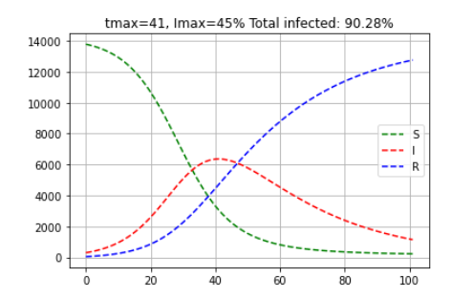
Spread of infection in Balichak
Applying the SIR Model with population of BALICHAK = 13784 and infected peoples= 12*25trains = 300

Slide 40
Between 4th and 5th Time Interval
Number of peoples boarding at BHALICHAK= 190
Infected peoples boarding at BHALICHAK = (10/275)*190 = 6.91 = 7(Approx)
Total infected people in train when train starts at BHALICHAK =
28+ 27 -2 + 2 + 62 -2 + 2 +72 – 12 + 7= 184

Slide 41
5th Time Interval
Train is travelling from BHALICHAK to RADHAMOHANPUR
Totals contacts taking place = 15776
Contacts taking place with infected nodes = 6372
Peff = 6372/15776 = 0.4039 = 40.39%
Number of newly infected people in the train in time-interval t =4 is
= (275-5+13-11+33-6+46 -30 +190-173)*0.4039 = 135 (Approx.)
Number of infected people de-boarding at RADHAMOHANPUR= 0.4039*7 = 3 (Approx)
Total infected people in train = 184 + 135 = 319 peoples.

Slide 42
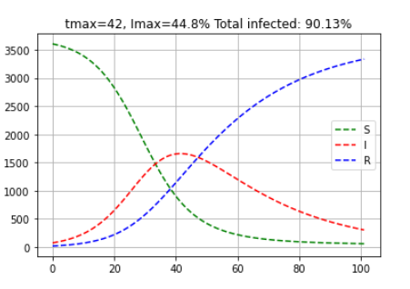
Spread of infection in Radhamohanpur
Applying the SIR Model with population of RADHAMOHANPUR = 3604 and infected peoples= 3*25trains = 75

Slide 43
Between 5th and 6th Time Interval
Number of peoples boarding at RADHAMOHANPUR= 83
Infected peoples boarding at RADHAMOHANPUR = (10/275)*83 = 3.01 = 3 (Approx)
Total infected people in train when train starts at RADHAMOHANPUR = 319-3 +3 = 319

Slide 44
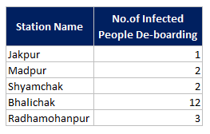
INFECTED PEOPLE DE-BOARDING
Number of Infected people de-boarding at each station is captured for SIR Model which we have seen previously.

Slide 45
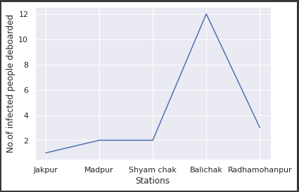
INFECTED PEOPLE DE-BOARDING

Slide 46
Basics of Social Activity Network
We have modelled the PEN network from KHARAGPUR to RADHAMOHANPUR for the spread of infection.
Now to incorporate the Social Activity Network, we need to create a new contact network based on the locations of boarding and de-boarding of passengers.
The contacts will be developed between the persons boarding and de-boarding at different places.

Slide 47
Challenges In SA Network
The interaction of two different networks in a single time interval t.
When the train is travelling in one network, the SA contacts will be established in the next few stations where the train is about to reach.
Similarly, when the train left particular station, and SA network will be established among the passengers already de-boarded the train.

Slide 48
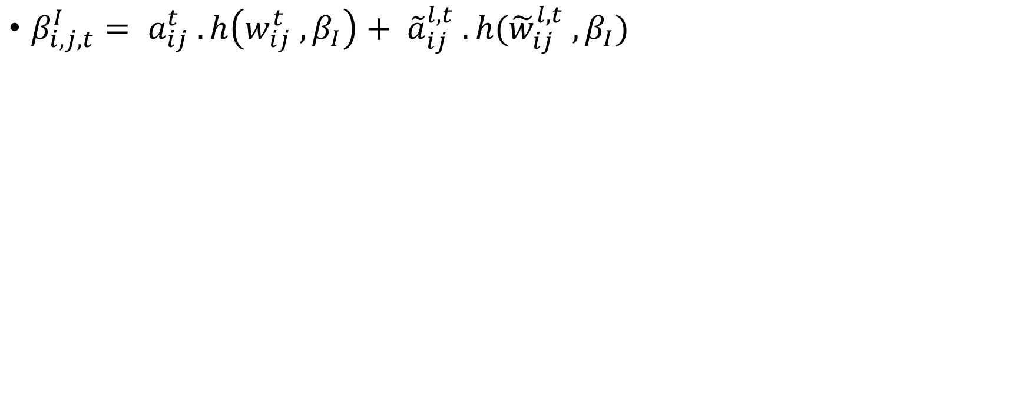
Impact of SA network
The probability of a susceptible node i getting infected from an infected node j i.e. Beta ijt I will be changed as the SA network term will come into the equation now.

Slide 49

Impact of Social Activity on PEN Contact Network
The impact of SA in the available contact network will increase the contacts taking place in the stations.
The journey starts from Kharagpur and there are 275 passengers boarding the train.
A Social Activity network is developed between 275 passengers and the number of contacts taking place in the station = = 37675 contacts.
The weight (varying between 0 and 1) and the intensity of spread of the disease will depend on the epidemic conditions prevailing in the respective station.

Slide 50
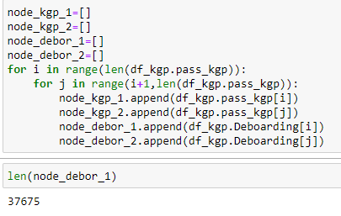
Steps involved in updating the contact network – for station KGP
Finding a list of passengers boarding at KGP.
Developing contacts between 275 nodes.

Slide 51
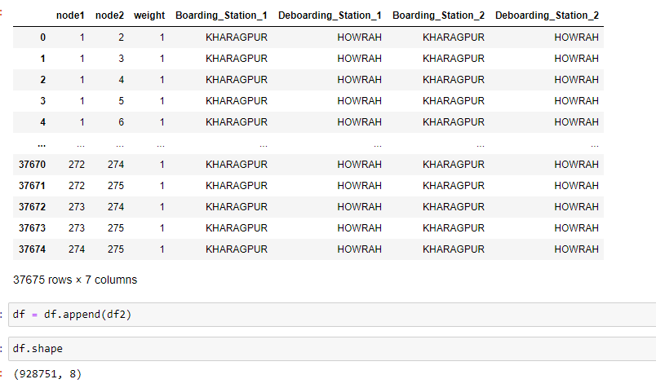
Updated Contact Network
3. Updating the data frame with the newly formed contacts.

Slide 52
1st Time Interval
Train is travelling from KHARAGPUR to JAKPUR
Total contacts taking place = 42720
Contacts taking place with infected nodes = 3071
Peff = 3071/42720 = 0.07188 = 7.18%
Number of infected people in the train after time-interval t =1 is = (265*0.07188) + 10 = 29.04 = 29 (Approx.)

Slide 53

1st Time Interval
The nodes getting infected during 1st Time Interval:
Number of infected people de-boarding at Jakpur
= 5*0.07188 = 0.36 = 1 (approx.)(Node 2)

Slide 54
Spread of infection in JAKPUR
Applying the SIR Model with population of JAKPUR = 1341 and infected peoples= 1*25trains = 25

Slide 55
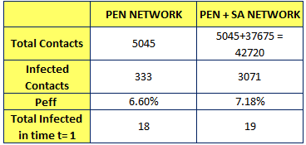
Comparison of the two results

Slide 56

Impact of Social Activity on PEN Contact Network at JAKPUR
The journey starts from Jakpur and there are 13 passengers boarding the train.
A Social Activity network is developed between 13 passengers and the number of contacts taking place in the station = = 78 contacts.
The weight (varying between 0 and 1) and the intensity of spread of the disease will depend on the epidemic conditions prevailing in the respective station.
Contact Network is developed at Jakpur using the earlier procedure.

Slide 57
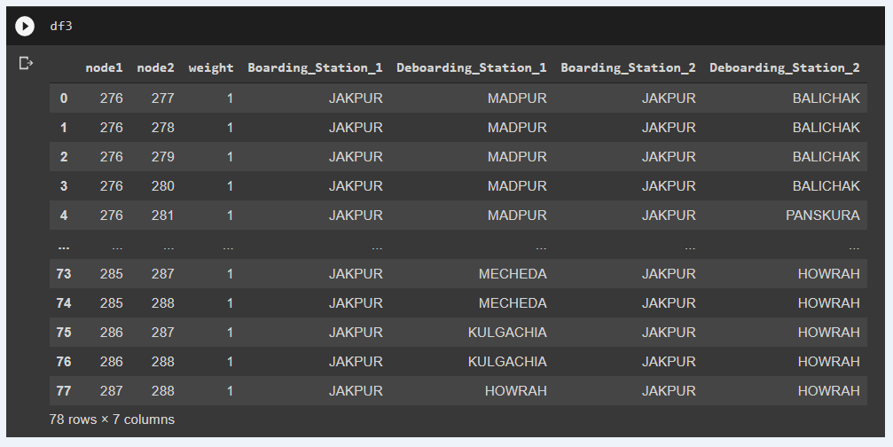
Contact Network at Jakpur

Slide 58
2nd Time Interval
Train is travelling from JAKPUR to MADPUR
Total contacts taking place = 41895
Contacts taking place with infected nodes = 8742
Peff = 8742/41895= 0.20866= 20.86%
Number of infected people in the train after time-interval t =2 is = (254*0.20866) + 29 = 53.00 + 29 = 82 (Approx.)

Slide 59
Comparison Of Results

Slide 60
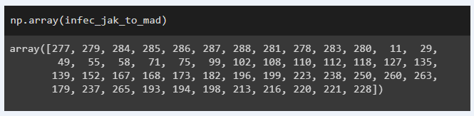
2nd Time Interval
The nodes getting infected during 2nd Time Interval:
Number of infected people de-boarding at Madpur
= 11*0.20866 = 2.295 = 3 (approx.)(Nodes 6,12,276)

Slide 61
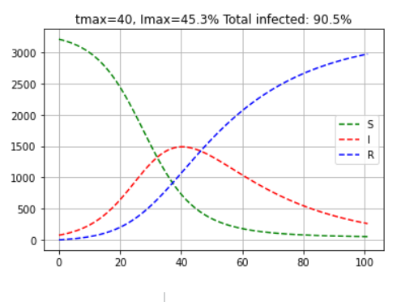
Spread of infection in Madpur
Applying the SIR Model with population of MADPUR = 3210 and infected peoples= 3*25trains = 75

Slide 62
Between 2nd and 3rd Time Interval
Number of peoples boarding at MADPUR = 33
Infected peoples boarding at MADPUR = (10/275)*33 = 1.2 = 2(Approx) (Node 313 and Node 315)
Total infected people in train when train starts at MADPUR = 82-3+2
= 81 (peoples)

Slide 63
3rd Time Interval
Train is travelling from MADPUR to SHYAMCHAK
Totals contacts taking place =40699
Contacts taking place with infected nodes = 8960
Peff = 8960/40699 = 0.22015 = 22.015%
Number of newly infected people in the train in time-interval t =3 is
= (275-5+13-11+33-57)*0.22015 = 54.4 = 54 (Approx.)
Number of infected people de-boarding at SHYAMCHAK = 0.22015*6 = 1.32 = 2 (Approx)
Total infected people in train = 81+ 54 + 2 = 137 peoples.

Slide 64
Comparison Of Results

Slide 65
Spread of infection in Shyamchak
Applying the SIR Model with population of SHYAMCHAK = 252 and infected peoples= 2*25trains = 50

Slide 66
Between 3rd and 4th Time Interval
Number of peoples boarding at SHYAMCHAK = 46
Infected peoples boarding at SHYAMCHAK = (10/275)*46 = 1.672 = 2(Approx)
Total infected people in train when train starts at SHYAMCHAK =
137 -2 + 2 = 137

Slide 67
4th Time Interval
Train is travelling from SHYAMCHAK to BHALICHAK
Totals contacts taking place = 43731
Contacts taking place with infected nodes = 18893
Peff = 18893/43731 = 0.4320 = 43.20%
Number of newly infected people in the train in time-interval t =4 is
= (275-5+13-11+33-6+46-135)*0.4320 = 90 (Approx.)
Number of infected people de-boarding at BHALICHAK= 0.4320*30 = 13 (Approx)
Total infected people in train = 137 + 90 = 227 peoples.

Slide 68
Comparison Of Results

Slide 69
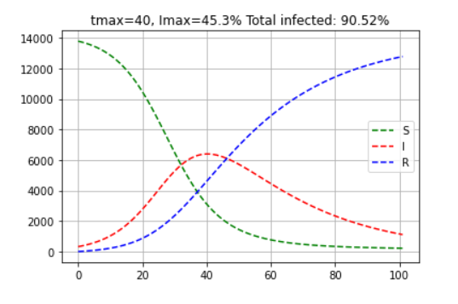
Spread of infection in Balichak
Applying the SIR Model with population of BALICHAK = 13784 and infected peoples= 13*25trains = 325

Slide 70
Between 4th and 5th Time Interval
Number of peoples boarding at BHALICHAK= 190
Infected peoples boarding at BHALICHAK = (10/275)*190 = 6.91 = 7(Approx)
Total infected people in train just before train stops at BHALICHAK = 227
Total infected people in train when train starts at BHALICHAK =
214 – 16 + 7 = 218

Slide 71
5th Time Interval
Train is travelling from BHALICHAK to RADHAMOHANPUR
Totals contacts taking place = 62262
Contacts taking place with infected nodes = 33145
Peff = 33145/62262= 0.5323= 53.23%
Number of newly infected people in the train in time-interval t =5 is
= (275-5+13-11+33-6+46-135+190-32)*0.5323= 152(Approx.)
Number of infected people de-boarding at BHALICHAK= 0.5323*9= 6 (Approx)
Total infected people in train when train reaches Radhamohanpur = 218 + 152 = 370 peoples.

Slide 72
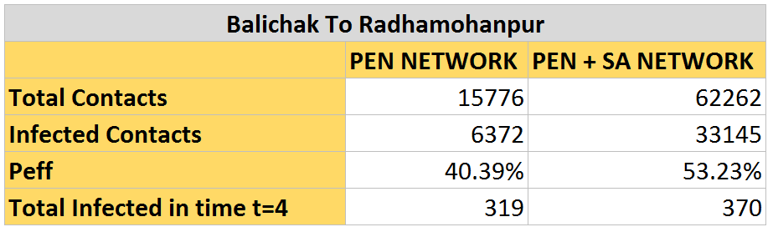
Comparison Of Results

Slide 73
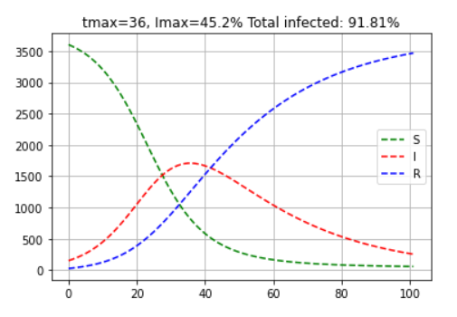
Spread of infection in Radhamohanpur
Applying the SIR Model with population of RADHAMOHANPUR = 3604 and infected peoples= 6*25trains = 150

Slide 74
Medical facilities to available (arbitrary)
Covid beds available:
Jakpur – 5 beds
Madpur – 10 beds
Shyamchak – 5 beds
Balichak – 30 beds
Radhamohanpur – 15 beds
Infected people de-boarding
Jakpur – 1 / train
Madpur – 3/train
Shyamchak – 2/train
Balichak – 13/train
Radhamohanpur – 6/train

Slide 75
Final Inference
Considering the medical facility in the 5 stations shown and the infected people de-boarding at each station, we can say that max 2 trains can be run during the pandemic.
If we want to run more trains, then the medical facility needs to be improved.

Slide 76
THANK YOU

